Slide 1
Correctness
A Quick Peek at Software Verification
Week 1 / Lecture 3
Franck Chauvel
Axbit & NTNU
franck.chauvel@ntnu.no

Slide 2

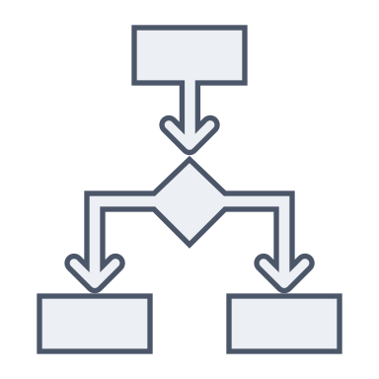


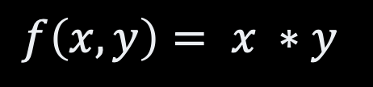
Remember…
Programs
Algorithms
Problems
correctness
Algorithm 1
$$f\left(x,y\right)= x ∗y$$
efficiency
Algorithm 2

Slide 3

Example: Product
program product (x, y):
begin
product := 0;
counter := 0;
while counter != y
do
product := product + x;
counter := counter + 1;
end
end
Does it compute $f\left(x,y\right)=x∗y$?
Does it always do?
Why?

Slide 4
Agenda
What does it mean to be “correct”?
How to prove it?
What about testing it?

Slide 5
Correctness?
Partial correctness
May not terminate
No invalid output for a valid input
“Full” correctness
Partial Correctness
Always terminates

Slide 6


How to Argue for Correctness?
TEST
PROVE

Slide 7
Proofs
Formal Software Verification

Slide 8
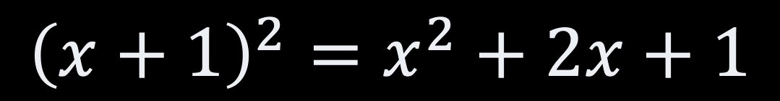
Proofs
$${\left(x+1\right)}^{2}=x^{2}+2x+1$$

Slide 9

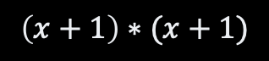
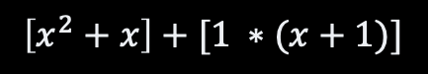

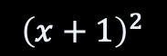
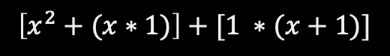
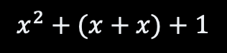
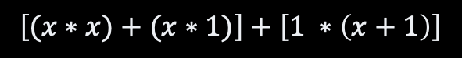
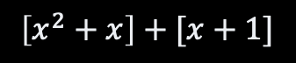


A Formal Proof
$${\left(x+1\right)}^{2}$$
definition of the square function
$$\left(x+1\right)∗(x+1)$$
$$x^{2}+2x+1$$
distributivity of x over +
Definition of x
$$\left[x ∗\left(x+1\right)\right]+[1 ∗(x+1)]$$
$$x^{2}+(x+x)+1$$
distributivity of x over +
associativity of +
$$\left[(x∗x)+(x∗1)\right]+\left[1 ∗\left(x+1\right)\right]$$
$$\left[x^{2}+x\right]+[x+1]$$
definition of the square function
identity element of x
$$\left[x^{2}+(x∗1)\right]+[1 ∗(x+1)]$$
$$\left[x^{2}+x\right]+\left[x+\left(1∗1\right)\right]$$
identity element of x
identity element of x
$$\left[x^{2}+x\right]+[1 ∗(x+1)]$$
$$\left[x^{2}+x\right]+\left[\left(1∗x\right)+\left(1∗1\right)\right]$$
distributivity of x over +

Slide 10
Deduction System for RAM
Machine State 1
INST 1
Machine State 2
INST 2
INST N-1
Machine State N

Slide 11
Remember the RAM
Code | Mnemonic | Parameter | Semantic
1 | LOAD | value | ACC := value IP := IP + 2
2 | ADD | address | ACC := ACC + memory[address] IP := IP + 2
3 | SUBTRACT | address | ACC := ACC - memory[address] IP := IP + 2
4 | STORE | address | memory[address] := ACC IP := IP + 2
5 | JUMP | address | if ACC = 0 then IP := address else IP := IP + 1
6 | READ | address | memory[address] := input IP := IP + 2
7 | PRINT | address | output := memory[address] IP := IP + 2
? | HALT

Slide 12
Formal Proofs of RAM Programs
CPU
Memory
CPU
Memory
each := each + 1
ACC
each
x
ACC
each
x+1
IP
IP
Pseudo-code
Executor before
Executor after

Slide 13
Proving Programs
ACC := value
IP := IP + 2
LOAD value
Pseudo-code
each := each + 1
CPU
Memory
CPU
Memory
ACC
each
x
ACC
1
each
x
y
y+2
IP
IP
y
y
LOAD
LOAD
LOAD
y
LOAD
1
1
y+1
1
y+1
1
RAM assembly
y+2
ADD
y+2
ADD
load 1 add each store each
ADD
load 1 add each store each
each
each
y+3
y+3
each
y+4
STO
y+4
STO
y+5
each
y+5
each

Slide 14
Proving Programs
ACC := ACC + memory[address]
IP := IP + 2
ADD address
Pseudo-code
each := each + 1
CPU
Memory
CPU
Memory
ACC
1
each
x
ACC
x+1
each
x
y+2
y+2
IP
IP
y+4
y
LOAD
y
LOAD
y+1
1
y+1
1
RAM assembly
y+2
ADD
ADD
load 1 add each store each
ADD
y+2
ADD
each
each
y+3
each
y+3
each
y+4
STO
y+4
STO
STO
each
each
y+5
y+5
each

Slide 15
Proving Programs
memory[address] := ACC
IP := IP + 2
STORE address
Pseudo-code
each := each + 1
CPU
Memory
CPU
Memory
x
x+1
ACC
x+1
each
ACC
x+1
each
x
y+4
y+6
IP
IP
y+4
y
LOAD
y
LOAD
y+1
1
y+1
1
RAM assembly
load 1 add each store each
y+2
ADD
y+2
ADD
y+3
each
y+3
each
y+4
STO
y+4
STO
STO
each
each
y+5
y+5
each

Slide 16
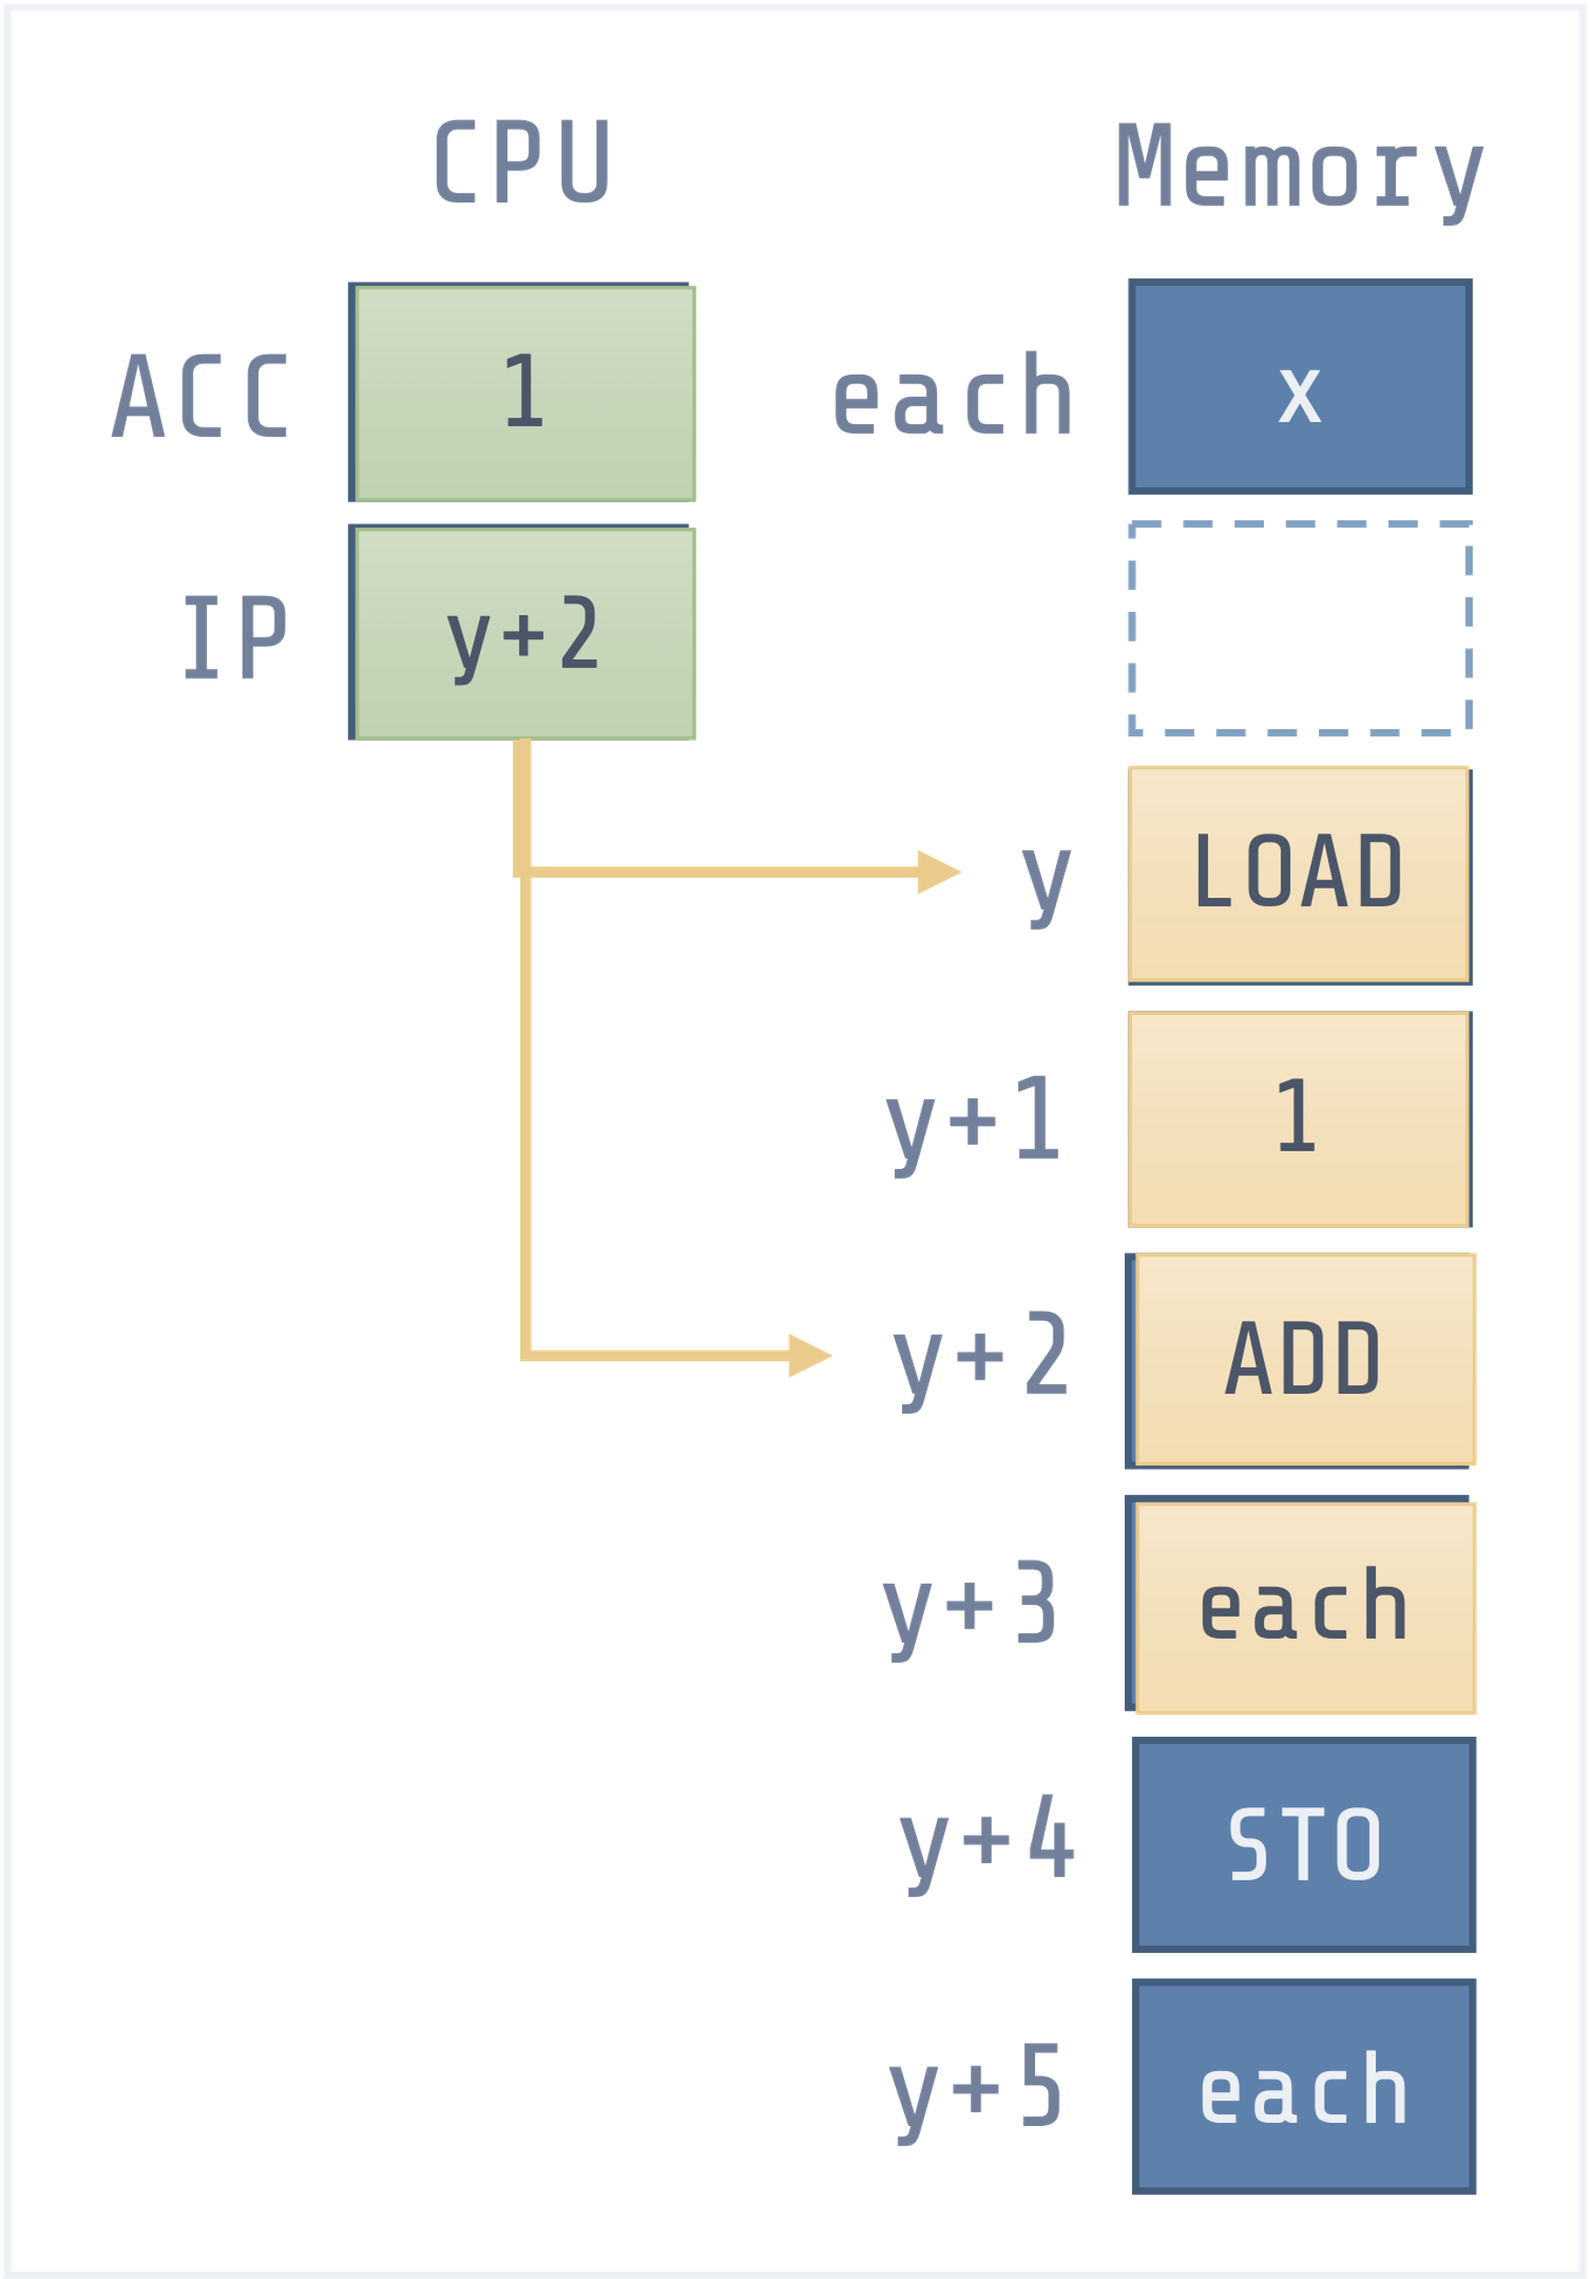
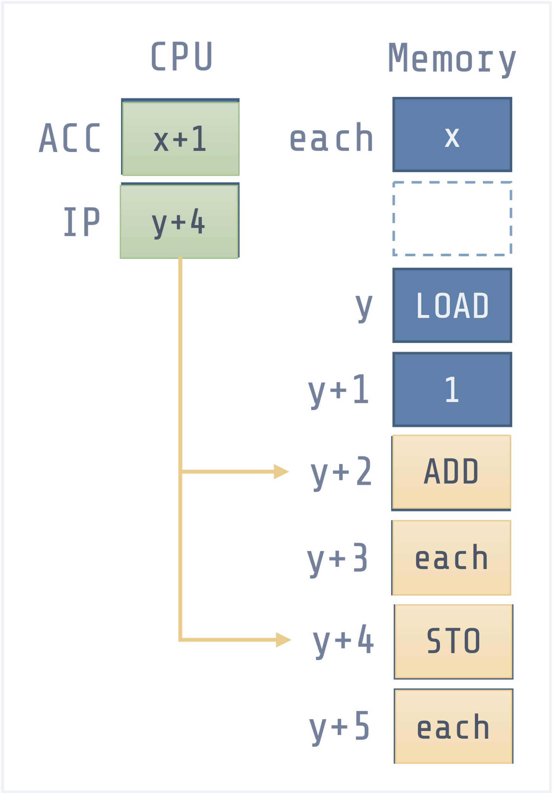
Proving Programs
CPU
Memory
CPU
Memory
each := each + 1
ACC
each
x
ACC
each
x+1
IP
IP
Pseudo-code
Executor before
Executor after
LOAD 1
ADD address
STORE address

Slide 17
Takeaway #1
Proofs over assembly code is a pain

Slide 18

Example: Product
program product (x, y):
begin
product := 0;
counter := 0;
while counter < y
do
product := product + x;
counter := counter + 1;
end
end
Does it compute $f\left(x,y\right)=x∗y$?
Why?
Does it always do?

Slide 19
Deduction System for Pseudocode
Set of Variables 1
CMD 1
Set of Variables 2
CMD 2
CMD N-1
Set of Variables N

Slide 20
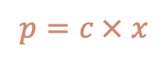
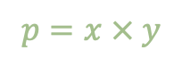
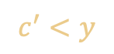
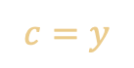
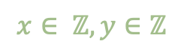
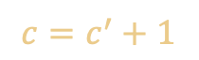
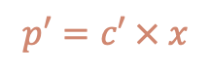
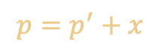
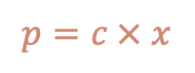
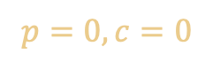
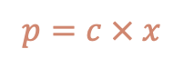
Multiplication
Start
$$x∈ ℤ, y∈ℤ$$
product := 0;
counter := 0;
Loop invariant
Always true:
Before, during and after.
$$p=x × y$$
$$p=0, c=0$$
$$c=y$$
$$p=c × x$$
$$p=c × x$$
counter != y
[no]
Done
$$p=p^{′}+x$$
$$c^{′}<y$$
$$c=c^{′}+1$$
[yes]
$$p′=c′ × x$$
$$p=c × x$$
product := product + x;
counter := counter + 1;

Slide 21
Takeaway #2
Proofs are hard,
but they do help understand algorithms

Slide 22
Testing Practical Software Verification

Slide 23
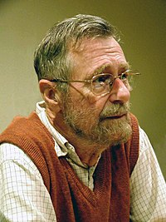
“Testing shows the prescence, not the absence of bugs”
— Edsger W. Dijkstra (1930 – 2002)

Slide 24

How to Test?
Implement our algorithm
Try with some inputs
Check if the output is as you expect

Slide 25
Testing Termination
program product (x, y):
begin
product := 0;
counter := 0;
while counter < y
do
product := product + x;
counter := counter + 1;
end
end
How long shall we wait?
Has it failed?

Slide 26
Test Case Selection
Which inputs to choose?
How many test cases?
X | Y | Expect | Found
0 | 23 | 0 | 0
5 | 1 | 5 | 5
42 | 10 | 420 | 420
27 | 13 | 351 | 352

Slide 27
Assertions to “debug”
program product (x, y):
begin
assert x > 0 and y > 0;
product := 0;
counter := 0;
assert product == counter * x;
while counter != y
do
product := product + x;
assert product == counter * x;
counter := counter + 1;
end
assert counter == y;
assert product == counter * x;
end
Checks in the code
things are “OK” so far
What to check?
pre conditions
post conditions
loop invariants
Most language have native support

Slide 28
Recap
Correctness
Always expected output
Always terminate
Proofs?
Yes, but hard.
Testing?
Not enough. Only give counter examples.
Two approach to “understand” an algorithm:
Prove it correct (pen & paper)
Implement, test & debug (keyboard)

Slide 29
Questions, Comments, or Ideas?
Franck Chauvel
Axbit & NTNU
franck.chauvel@ntnu.no

Slide 30
What is the Problem?
Requirements
Function
Decidability?
There is not an algorithm for every problem!
input
Problem
output

Slide 31
Recap
Correctness
Correct result
Termination
Testing
Practical but weak
Only shows there is a problem
Proofs
Stronger, but much harder
Require an model of computation
Inference Rules (Hoare Logic)
Loop invariants
In practice
Only Testing for most systems
Not only to find bugs
Testing is critical
Proofs + tests
Some safety critical systems
Cryptography
Device drivers

Slide 32
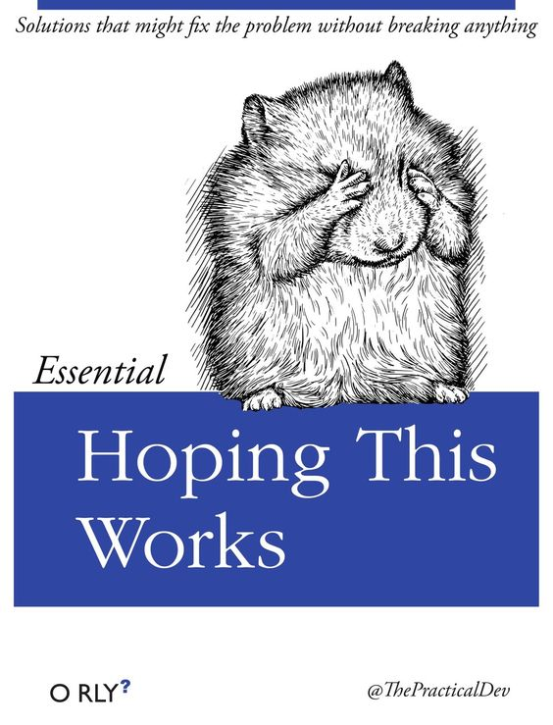
Lab Session
Unit Testing
Java with Junit
Python with Unittest
Javascript with Jest
C/C++ with Boost.test
Practical

